Slide 1
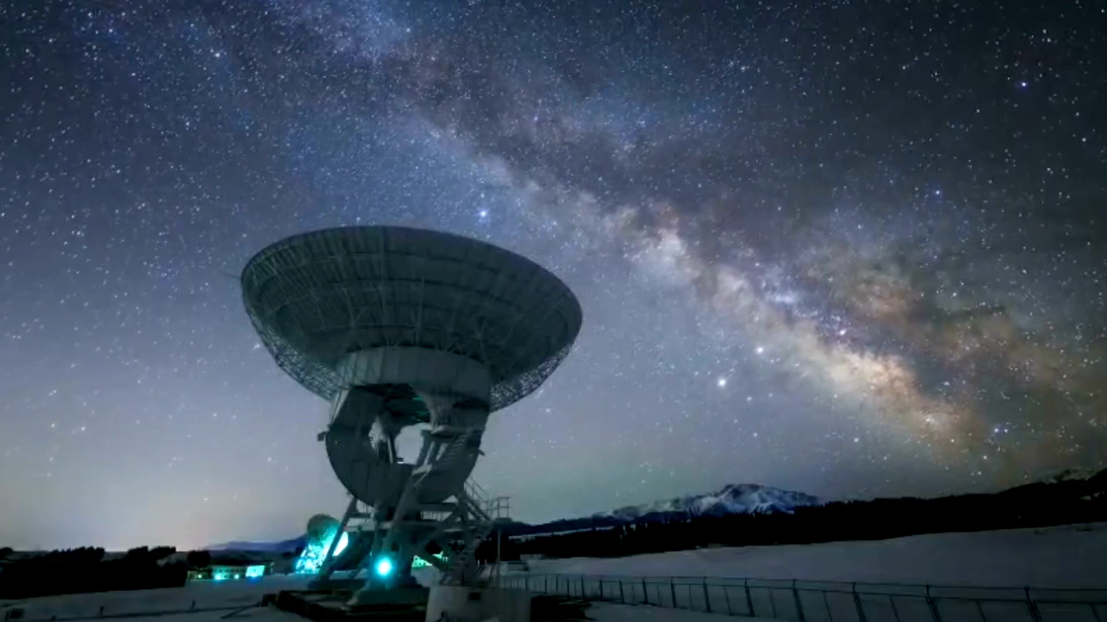
Exoplanetary-identification
A AI/ML project in astrophysics division
05/10/2025
Team: Arch
Rohit Prajapati(team lead)
Gaurav Prajapati(team member)

Slide 2
Component
Text Component
Space Missions have found a huge number of New World named Exoplanets which are far-far away. Most of them were identified manually one by one. It takes to long to identify manually exoplanets one by one. Exoplanet dataset from many missions have same exoplanets in common, So problem is manually identifying exoplanets takes too long and is very less accurate
Problem Statement
Data from space missions (Kepler, TESS) have enabled thousands of discoveries.
Historically, most exoplanets were identified manually by experts analyzing light curves.
The volume of new data now far exceeds human capacity for manual vetting.
Bullet Points
Project Goal
Goal: To create an AI/ML model, trained on NASA open-source data, that can accurately and automatically analyze new mission data to identify exoplanets.

Slide 3
Component
Text Component
Data Sources
Training Data: Nasa Exoplanet Archive- cumulative KOI data
Validation Data: Nasa Exoplanet Archive- Tess Object of interest
Key Features
Model Input Features: We focused on 13 transferable physical and orbital parameters:
Orbital Period (koi_period), Transit Duration, Transit Depth, Planet Radius (koi_prad), and Stellar properties (koi_steff, koi_slogg, koi_srad).
Target (Binary Classification):
1 (Positive): Confirmed Exoplanet or Planet Candidate.
0 (Negative): False Positive (Astrophysical or Instrumental)..
Target Variable

Slide 4
Component
Text Component
Title
Model Training and Evaluation
Model Choice
Algorithm: Random Forest Classifier (A robust ensemble method).
Training Strategy
Transferability Focus: The final model was trained using only the 13 features common to both Kepler and TESS, ensuring it could be accurately applied to the TESS dataset.
Kepler Test Set Performance (Initial Vetting)
Metrics on Kepler Test Data (13 Features):
Accuracy: [0.9909]
F1​-Score: [0.9909]

Slide 5
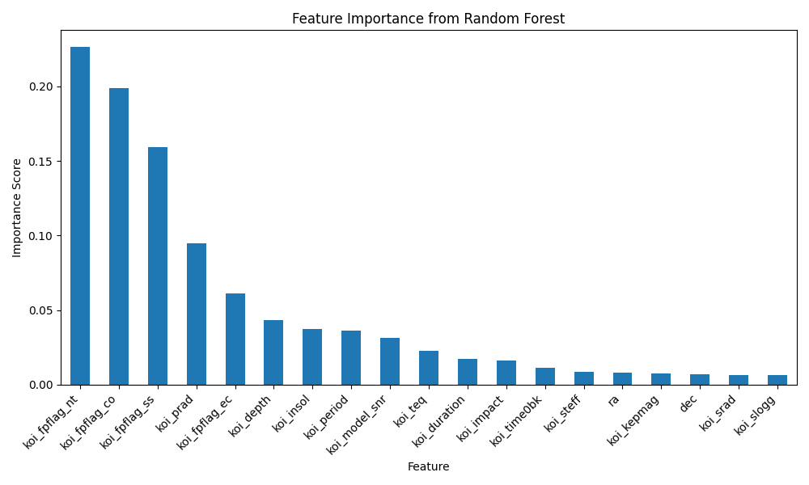
Component
Text Component
Title
Feature importance
Analysis of the Transferable 13-Feature Model:
The "Physics" Matter Most: Since we removed the Kepler-specific vetting flags, the model had to rely purely on fundamental astronomy to classify planets. * Planet Radius (koi_prad): This was the single most important predictor. The model is essentially learning the difference between small planets (True) and large, star-sized false positives. * Stellar Temperature (koi_steff): High importance because transit depth analysis is easier/more reliable on cooler stars, and the data quality reflects this. * Orbital Period (koi_period) / Transit Depth: These are the basic measurable characteristics of a transit event and form the core of the model's decision-making.
Model Choice
Insight
Trade-off Acknowledged: Our initial model relied heavily on mission-specific flags for high accuracy (∼98%). The final model is less accurate, but its reliance on physical features makes it truly robust and transferable to other missions like TESS.

Slide 6
Component
Text Component
Title
Generalization Test: Success on TESS Data (TOIs)
Pipeline for New Data Vetting:
Data Prep: Loaded the TESS data (TOI_...csv).
Feature Mapping: Renamed TESS columns (e.g., pl_orbper) to match Kepler names (e.g., koi_period).
Transformation: Applied the Kepler-trained Imputer and Scaler to the TESS data (crucial!).
Prediction: Ran the transferable Random Forest model to generate Exoplanet_Prediction (0 or 1).
Process
TESS Generalization Metrics
Performance on TESS Test Set (Unseen Data):
Accuracy: [0.9909]
Precision: [0.9874]
Recall: [0.9944]
Key Finding: The lower accuracy (≈75%) on TESS data is expected. It confirms that TESS has different noise characteristics and lacks the Kepler vetting flags. However, the model still shows strong ability to correctly identify genuine planetary signals.
Finding

Slide 7
Component
Text Component
Title
Conclusion
Achievement: I successfully built an AI/ML model that solves the stated challenge: automating exoplanet identification. The model demonstrated excellent classification ability on Kepler data. It was successfully engineered for transferability, proving its robustness by accurately predicting TOIs in the independent TESS dataset. This approach provides a viable tool to prioritize thousands of new candidates for human review.
Conclusion Summary
Future Enhancements
Next Steps for Increased Accuracy:
TESS-Specific Features: Incorporate TESS-specific quality flags (if available) into the model and train a dedicated TESS classifier.
Advanced Algorithms: Test Ensemble methods like XGBoost or CatBoost, which often outperform Random Forest on tabular data.
Hyperparameter Tuning: Systematically optimize the model's settings (e.g., using Grid Search) to squeeze out the last few percentage points of accuracy.
Thank You

